Slide 1


TITLE
Name SURNAME
SEP, 23rd | PARIS
DATA Analytics 2022

Slide 2

Use Case

Slide 3
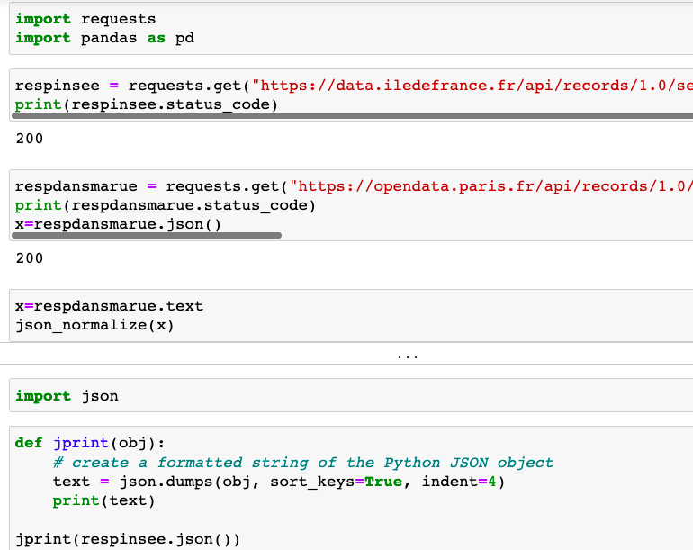
The Plan
Collect the data Via an API or direct download
Format the Json & Csv files
Use Pandas to analyze the data
Create a Database & Tables
Further analyze the data with queries

Slide 4
The data

Slide 5

Data cleaning & data prep
Using ‘str.replace’ and in some instances, with Regex
Removing accents using a lambda function & string encoding
Remove repetitive column variations using ‘drop
The data did not contain missing values

Slide 6
EDA

Slide 7
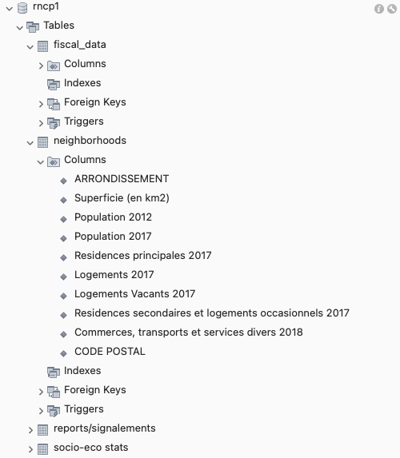
Database selection
Relationship database
Easy to conceive and set up
Most common
Easily reused

Slide 8
ERD

Slide 9
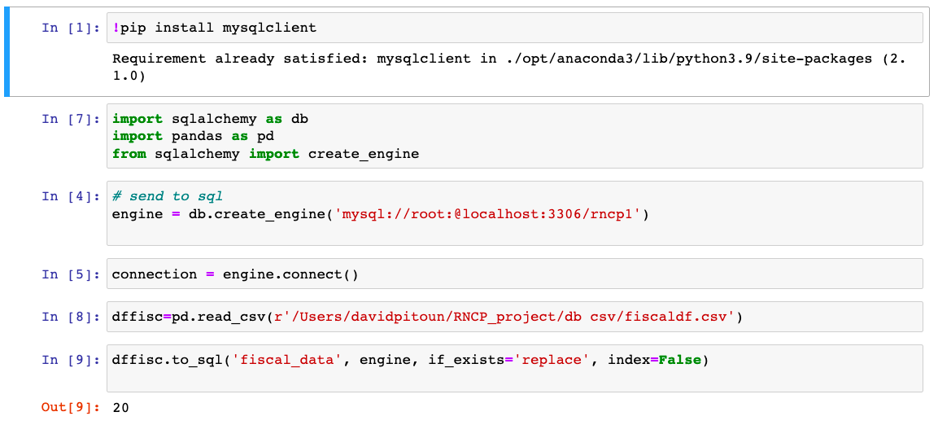
Data Insertion
SqlAlchemy / MySQL

Slide 10
Queries

Slide 11
Models

Slide 12
Models comparison

Slide 13
Insights and vizualisation

Slide 14

Conclusions
A Socio Economic divide
More technical knowledge and statistical knowledge could bring more insight
Normalized data population
Adding more databases to the study
Velib Roadwork,...

Slide 15
Thank You
Name SURNAME

